Slide 1
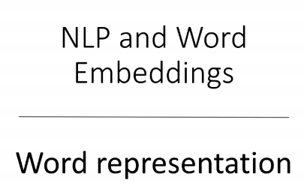
Copyright © www.ITbodhi.com

Slide 2
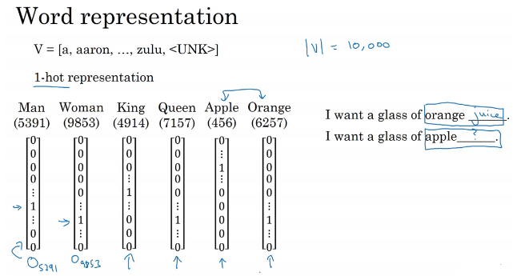
One hot encoding does not capture proximity or similarity among same type of words and all words are dissimilar to each other equivalently.
Copyright © www.ITbodhi.com

Slide 3
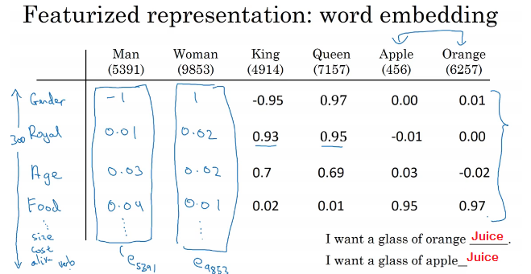
Here in word embedding, similar words has more or less similar presentation wrt to different features and that represents that they are similar.
Copyright © www.ITbodhi.com

Slide 4
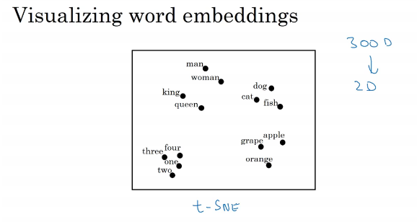
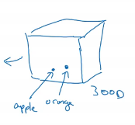
Copyright © www.ITbodhi.com

Slide 5
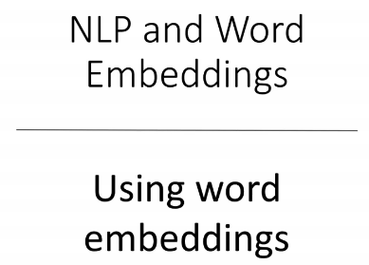
Copyright © www.ITbodhi.com

Slide 6
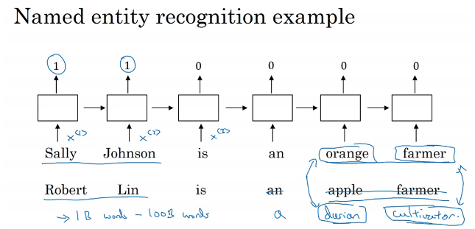
Train the word embedding model on very large un labeled data set 1 billion -100 billion to create word embedding and then use the same embedding in to your NLP programs like Named entity recognition for a very smaller data set 100k
Copyright © www.ITbodhi.com

Slide 7
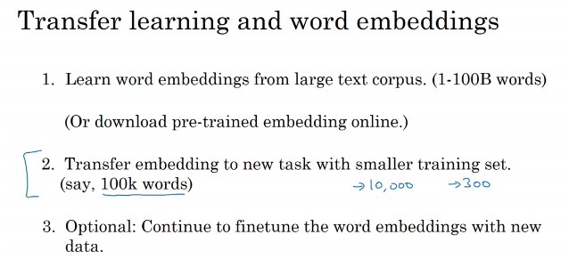
Train the word embedding model on very large un labeled data set 1 billion -100 billion to create word embedding and then use the same embedding in to your NLP programs like Named entity recognition for a very smaller data set 100k
Copyright © www.ITbodhi.com

Slide 8
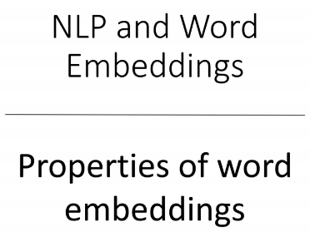
Copyright © www.ITbodhi.com

Slide 9
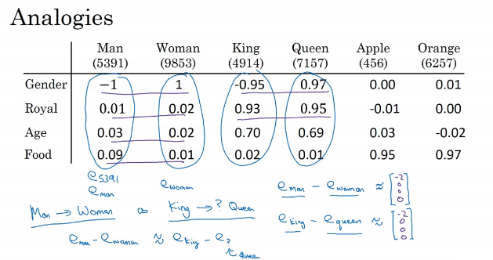
Copyright © www.ITbodhi.com

Slide 10
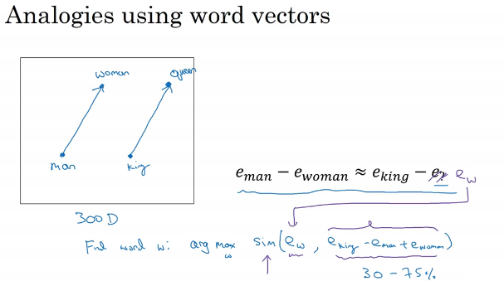
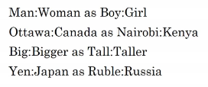
Vector difference between man-woman and king-queen will be approx. same.
Can use different distance function to measure similarity. Cosine similarity is most common and widely used.
Word embedding algorithm will learn the similarity like man-woman to boy-girl
Copyright © www.ITbodhi.com

Slide 11
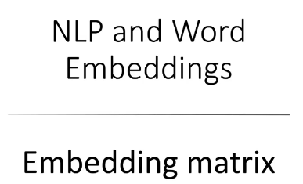
Copyright © www.ITbodhi.com

Slide 12
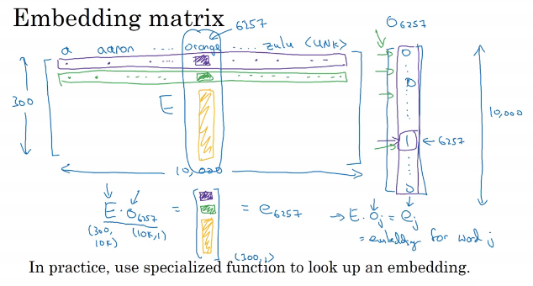
Copyright © www.ITbodhi.com

Slide 13
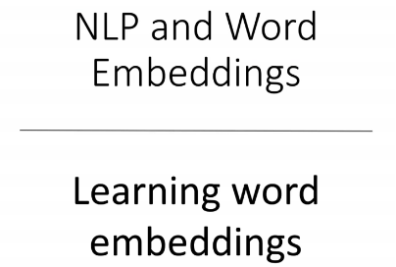
Copyright © www.ITbodhi.com

Slide 14
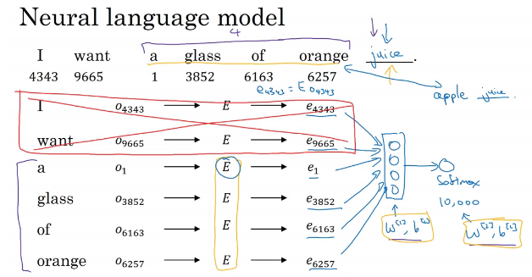
300 dimensional word embedding.
Now training neural network to predict word JUICE for given sentence and train all the weight for softmax layer, layer before softmax and all the weight for embedding matrix.
Number of predecessor words are fixed lets say we will predict the future word on basis of last 4 words.
Now all the weights are calculated using gradient descent and embedding for example apple and orange same to match next word juice
Copyright © www.ITbodhi.com

Slide 15
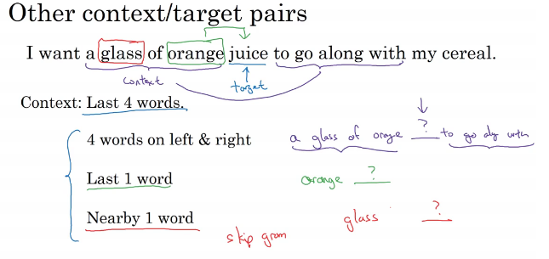
Context words could be any number of words and surprisingly single last word as a context do remarkably good for making word embedding.
Copyright © www.ITbodhi.com

Slide 16
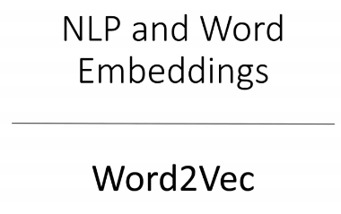
One of the simple technique to learn word embedding
Copyright © www.ITbodhi.com

Slide 17
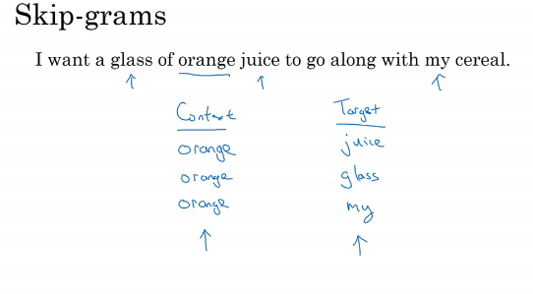
Not selecting the first or last word as context word.
Pick any word as context word and target word could be any word in given window length +5-5,+10-10
Now it is super wised learning problem with given word and target word prediction
Copyright © www.ITbodhi.com

Slide 18
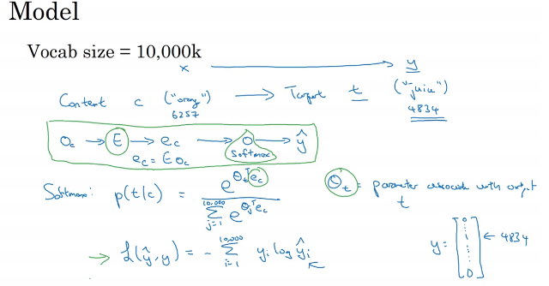
Applying softmax function to get probability of all target words.
Model is tuned to lean embedding matrix for the training data.
Copyright © www.ITbodhi.com

Slide 19
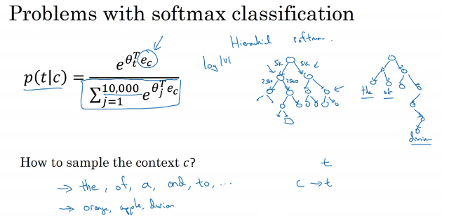
Hierarchical softmax is used to decrease the complexity of the calculation to total computations are reduced to log|v| where is total number of words in dictionary.
C has to be used so that most frequent words do not overshadow less common word. There are particular methods to do that
Copyright © www.ITbodhi.com

Slide 20
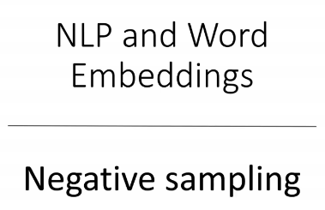
Similar to Skip Gram model but improving over softmax function
Copyright © www.ITbodhi.com

Slide 21
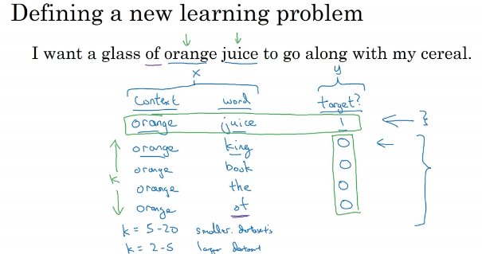
Pick word for positive sampling same as skip gram model
Pick negative word any random word from dictionary.
Now context and words are input for training and target matrix is the prediction. Simple super wised Problem .
Small data set K ( total sampling)=5-20 and K=2-5 for bigger data set.
Copyright © www.ITbodhi.com

Slide 22
This can be considered as 10,000 logistic regression at final layer
Each time neural network is trained only for K+1 ouputs and not all 10,000
Instead of having 10,000 dimension softmax we now have 10,000 binary classification problem that is comparatively very easy to calculate on K+1
Copyright © www.ITbodhi.com

Slide 23
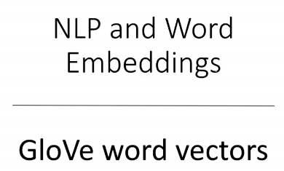
Copyright © www.ITbodhi.com

Slide 24
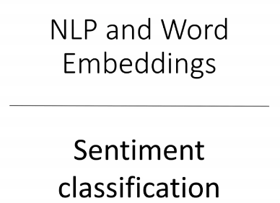
Copyright © www.ITbodhi.com

Slide 25
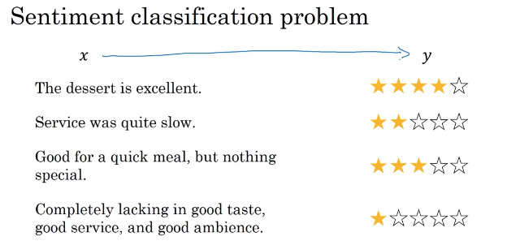
Problem : Might not have big labeled data set for model training.
Word embedding would perform great with small data set.
Copyright © www.ITbodhi.com

Slide 26
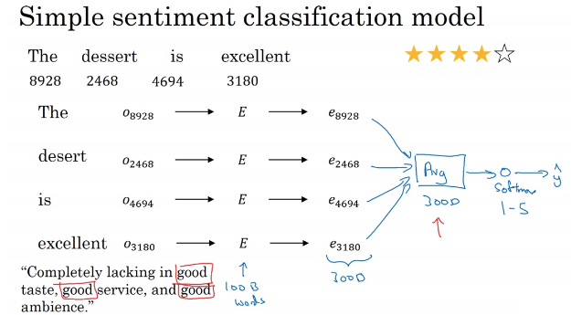
Problem : Averaging would not work great in the given example because word “good’ appear many times and model would predict that this is a positive feedback while it s a negative.
Use RNN for better results where time sequence is learned.
Copyright © www.ITbodhi.com

Slide 27
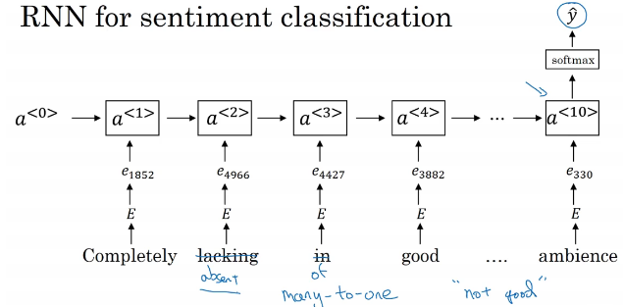
Even if any word is not present on test data set but because embedding is learned on a very big corpus of data , model will give very good results..
Copyright © www.ITbodhi.com

Slide 28
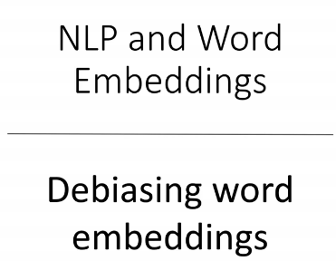
Copyright © www.ITbodhi.com

Slide 29
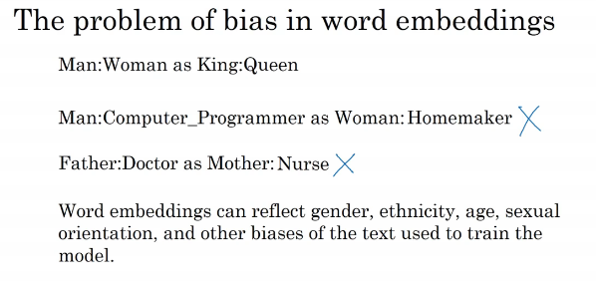
Embedding might gets biased due to training data set and based on different parameters.
i.e. Gender, Social condition, race & region etc.
Now that I very important your embedding to be unbiased because these embedding are used to make very important decisions in several ML applications like Job application screening, Criminal justice system ,Loan approval etc.
Copyright © www.ITbodhi.com

Slide 30
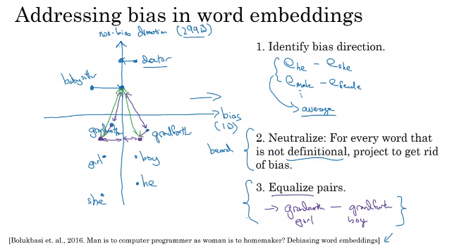
Complex Algorithm
Copyright © www.ITbodhi.com

Slide 31
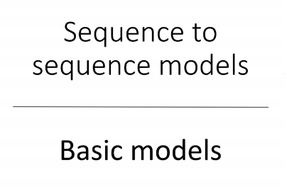
Copyright © www.ITbodhi.com

Slide 32
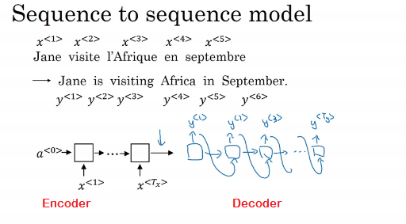
Used for Language Translation.
RNN with each layer LSTM or GRU
Copyright © www.ITbodhi.com

Slide 33
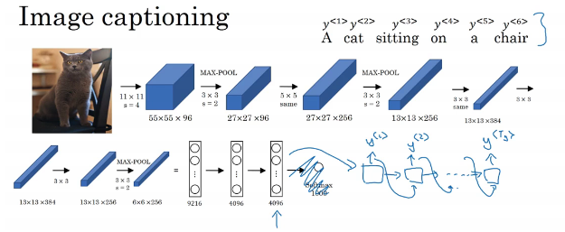
Encoder part is Alexnet and last FC layer represent the image in 4096 dimensions.
O/P from last FC layer becomes the I/P for Decoder RNN layer.
Copyright © www.ITbodhi.com

Slide 34
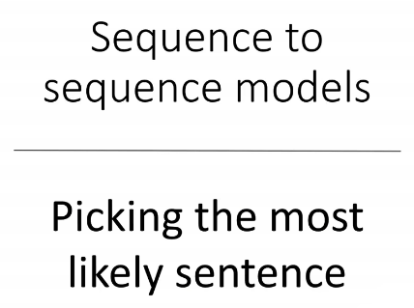
Copyright © www.ITbodhi.com

Slide 35
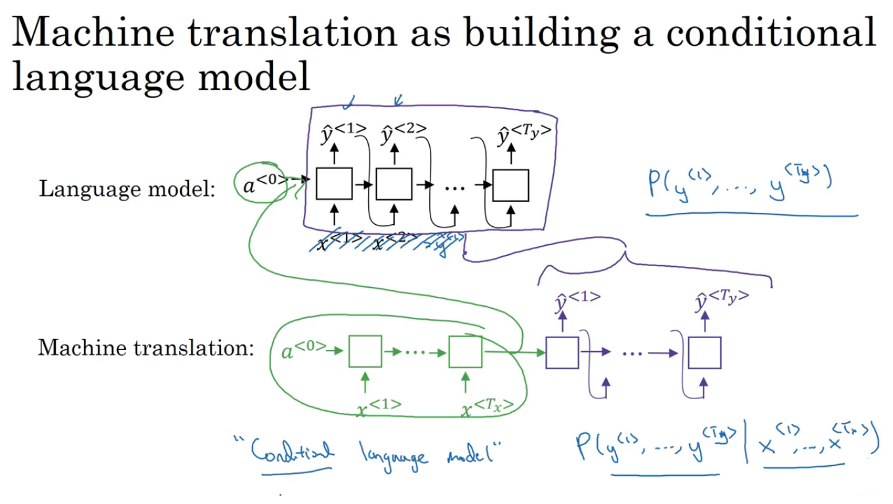
Machine Language model work more or less same way as Language model
You can see that Encoder part is just like replacing 0 initialization with Encoder o/p
So we can say that Machine Language model is Conditional Language Model where o/p of model is conditional over input is sentence in another language
Copyright © www.ITbodhi.com

Slide 36
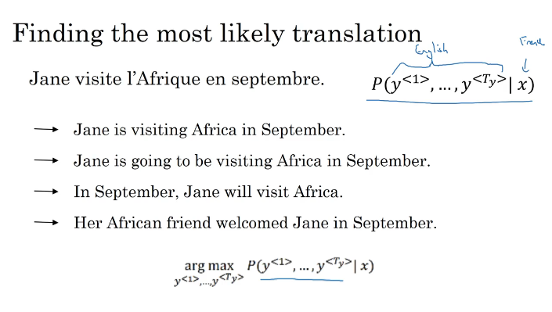
Random prediction is not preferable.
Model will try to predict the sentence for which probability of entire sentence as a whole is maximum not the individual words.
That method is classed BEAM Search.
Copyright © www.ITbodhi.com

Slide 37
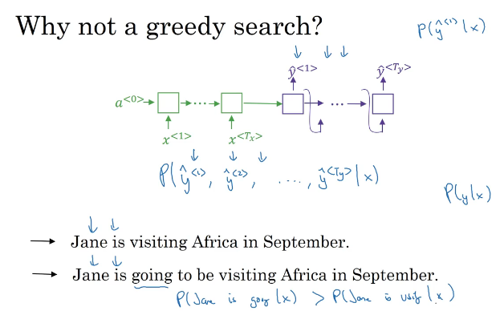
Greedy search method:- Will predict first word for which probability is maximum given earlier words.
It is observed that in Machine Translation greedy search results in to bas translation.
BEAM Search gives better results.
Copyright © www.ITbodhi.com

Slide 38
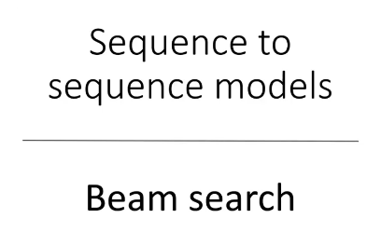
Copyright © www.ITbodhi.com

Slide 39
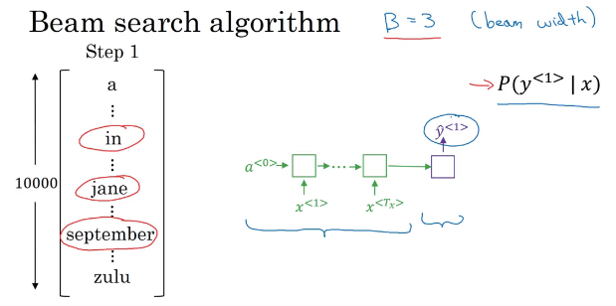
Beam search would predict not a single word which is most probable but a list of numbers which are most probable.
Beam width B is hyper parameter which can take any value 3,5,10 etc.
Copyright © www.ITbodhi.com

Slide 40
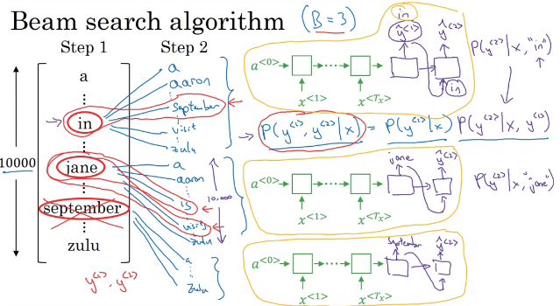
For each first 3 words predicted at first step, there would be three separate RNN for next 3 most probable words prediction.
There would be total 9 predictions for second word and the 3 pairs which has maximum probability would be chosen and other would be discarded. Softmax would be used for prediction o/p
In above example first word September branch would be completely discarded.
Copyright © www.ITbodhi.com

Slide 41
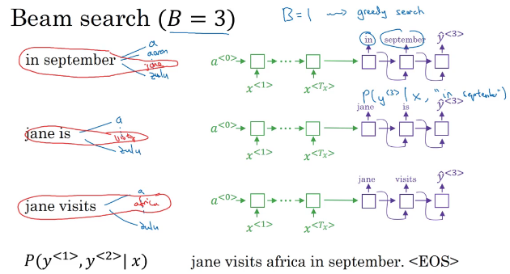
Process continues of selecting 3 most probable words till sentence is completed with EOS
If B=1 then process is just like Greedy Algorithm
Copyright © www.ITbodhi.com

Slide 42
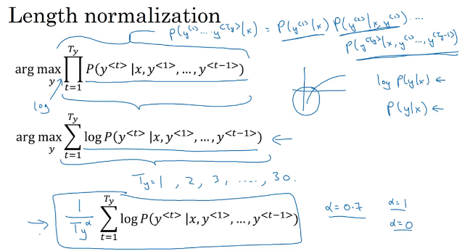
Probability of the word can be very very small and their product will be very very small quality and there could be rounding of error. To resolve this issue we take Logarithm of the probability and maximize the same.
To further optimize the issue we just normalize the probabilities with total number of words with power alpha
Copyright © www.ITbodhi.com

Slide 43
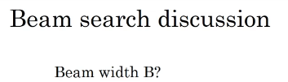
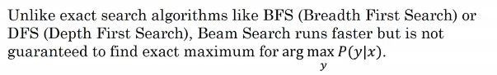
Very Big B : Better results , Slower
Very small B: Bad results, Faster
B=10 is considered good value while <10 are small while b=100 very big value
In research you can also find B=1000, or 3000 depend on application to application
Beam search is approx. search algorithm.
Copyright © www.ITbodhi.com

Slide 44
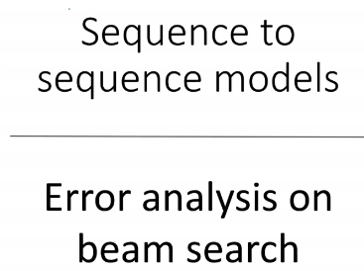
Copyright © www.ITbodhi.com

Slide 45
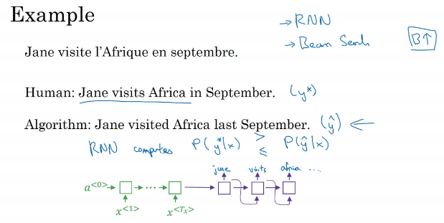
Y* is better translation than y^
But final prediction is y^
Now there could be two reasons: RNN at fault or Beam search at fault.
Copyright © www.ITbodhi.com

Slide 46
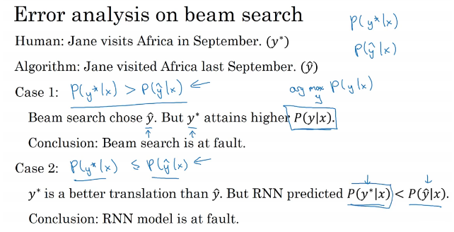
Copyright © www.ITbodhi.com

Slide 47
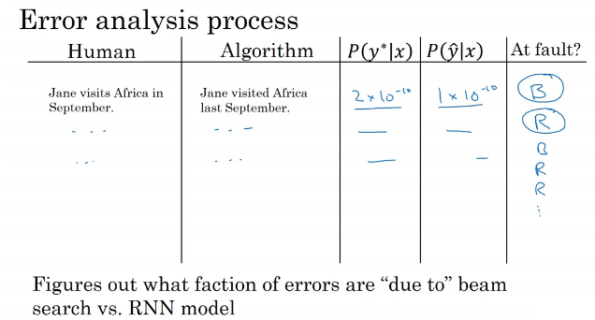
Beam search at fault: try with higher beam width
RNN at fault: More examples, Deep layers, Different structure of NN , Regularization etc.
Bleu score used to evaluate accuracy of translation
Copyright © www.ITbodhi.com

Slide 48
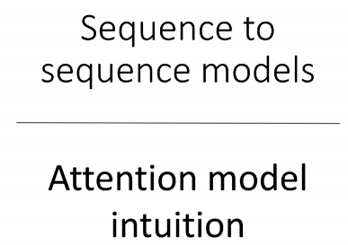
Better model for language translation
Copyright © www.ITbodhi.com

Slide 49

Longer the sentence , poorer the translation because NN has to memorize long sentence sequence.
Bleu score decreases with length of sentence i.e. translation become bad
Copyright © www.ITbodhi.com

Slide 50

Decoder now calculates how much attention it needs to give for each input words while predicting translated words and o/p from each encoder words goes to decoder words.
In given example using bidirectional RNN
Copyright © www.ITbodhi.com

Slide 51

Decoder now calculates how much attention it needs to give for each input words while predicting translated words and o/p from each encoder words goes to decoder words.
In given example using bidirectional RNN
Copyright © www.ITbodhi.com

Slide 52

Copyright © www.ITbodhi.com

Slide 53

Copyright © www.ITbodhi.com

Slide 54

Preprocess step may include converting audio clip in to Spectrogram which shows frequency at y axis and time a x axis. Intensity of different colors represents amount of energy , how loud is sound at different frequencies.
Copyright © www.ITbodhi.com

Slide 55

Different time frame of audio inputs as input for RNN.
Copyright © www.ITbodhi.com

Slide 56

Bi directional LSTM OR GRU RNN with Equal number of inputs and outputs.
In speech recognition number of input is generally very large as compared to output.
Lets say 10 seconds audio clip and speech comes as 100 hertz means 100 samples/frames per second = 10*100=1000 inputs
CTC can handle 10000 outputs to finally recognize very small output.
Copyright © www.ITbodhi.com

Slide 57

Copyright © www.ITbodhi.com

Slide 58

Copyright © www.ITbodhi.com

Slide 59

Just add all 0 before trigger word is said then after that output 1 for few seconds till next trigger words is said
Copyright © www.ITbodhi.com

